Slide 1
NEURAL NETWORKS, BACKPROPAGATION,
AND PATTERN RECOGNITION
Bryan Greener
Design & Analysis of Algorithms Spring 2018

Slide 2
WHY DO WE NEED THEM?
Pattern Recognition
Processing Speed
Solving Complex Algorithms
Memory Footprint
Developing Artificial Intelligence
Design & Analysis of Algorithms Spring 2018

Slide 3
WHERE ARE THEY USED?
Traffic Lights
Self-Driving Cars
Facial Recognition
Automated Data Input
Stock Market Prediction
NP Hard Algorithms
Medical Diagnostics
Loan Approvals
Entertainment
…and so much more!
Design & Analysis of Algorithms Spring 2018

Slide 4
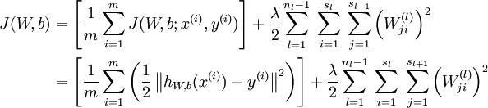
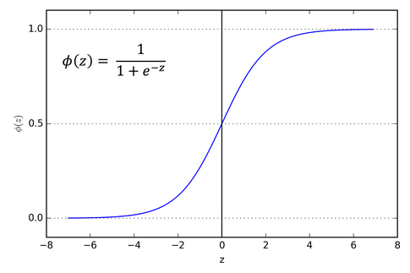
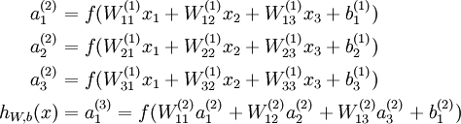
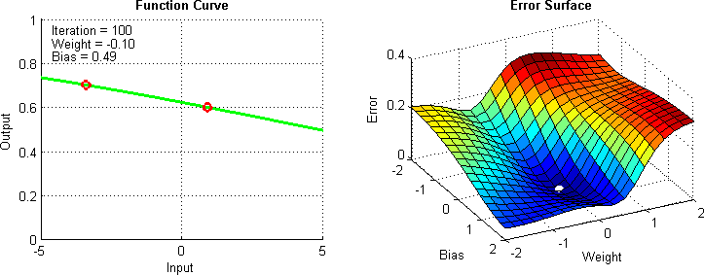
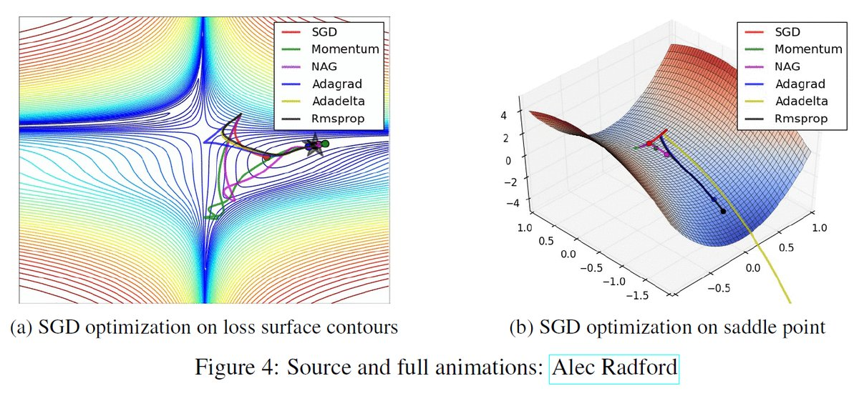
HOW DO THEY WORK?
Lots of math:
Design & Analysis of Algorithms Spring 2018

Slide 5
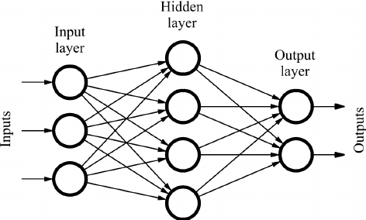
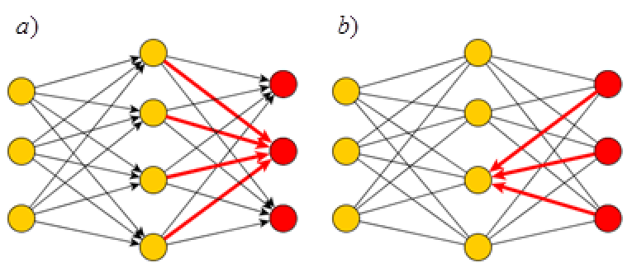
HOW DO THEY WORK?
Initialize matrices
Feed Forward
Calculate error at output layer
Backpropagate error
Update weights with gradient of cost function
Design & Analysis of Algorithms Spring 2018

Slide 6
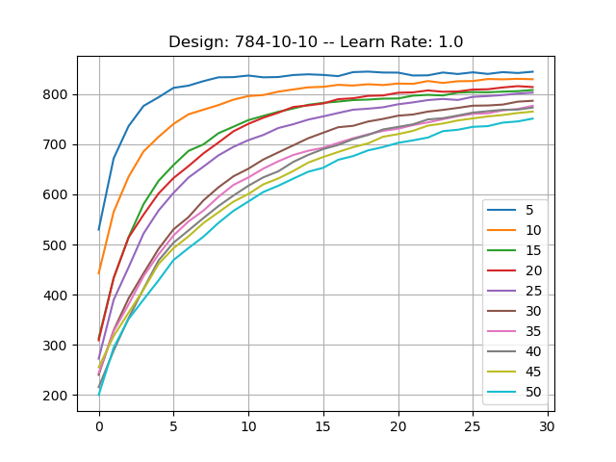
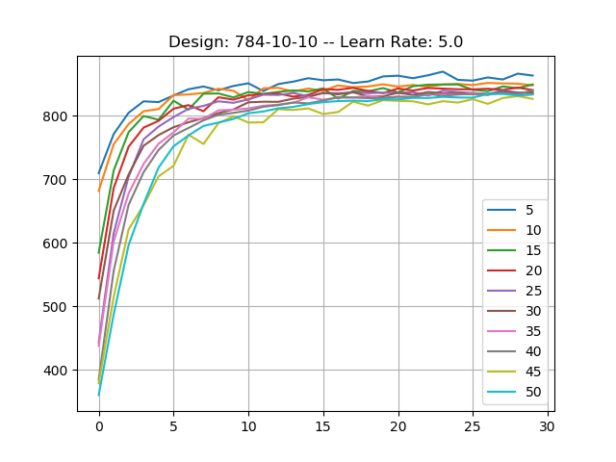
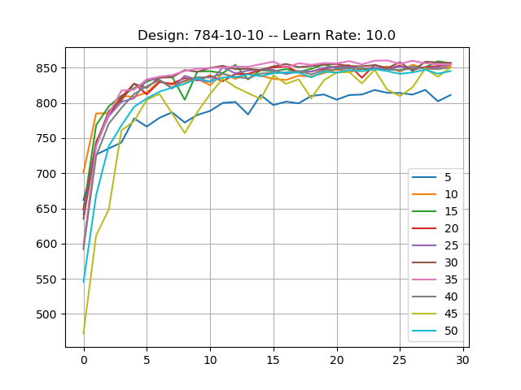
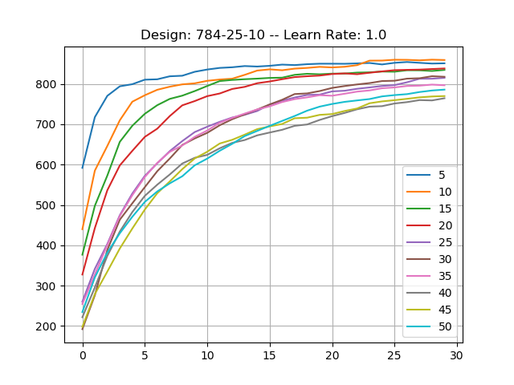
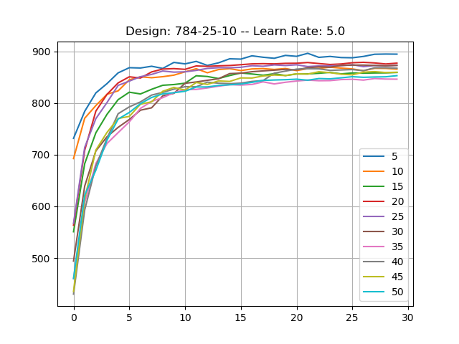
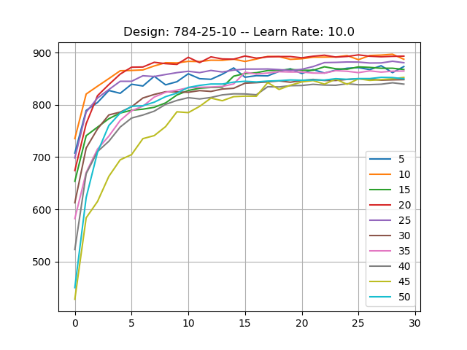
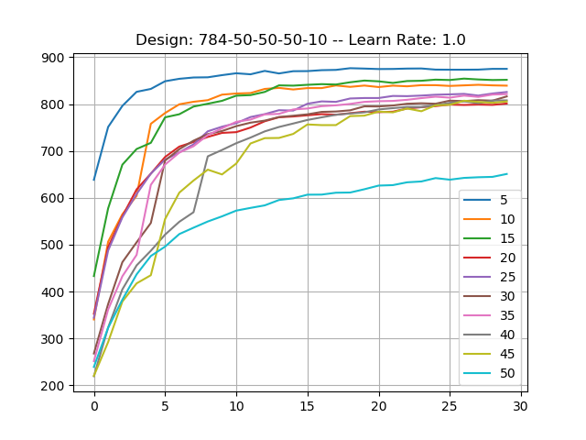
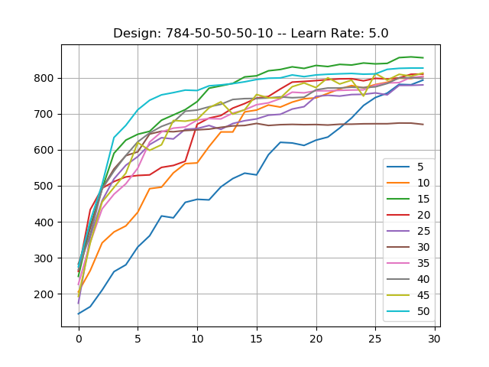
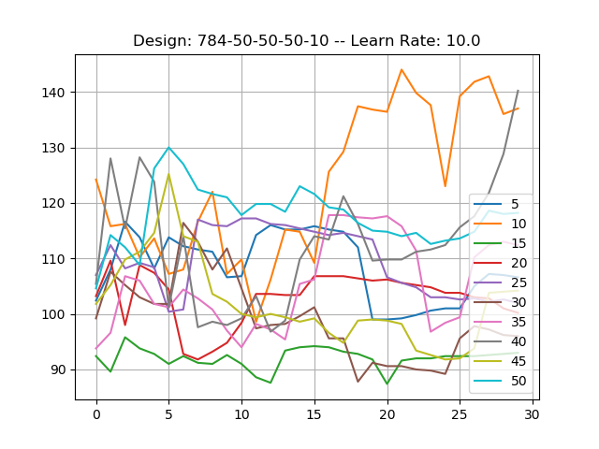
RESULTS:
Accuracy
Design & Analysis of Algorithms Spring 2018

Slide 7
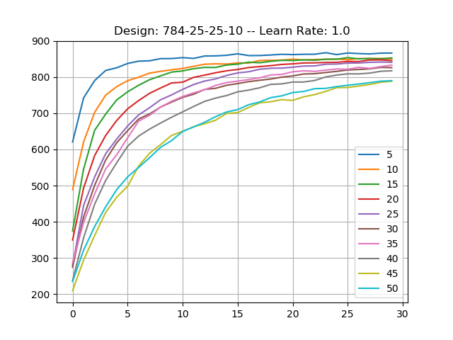
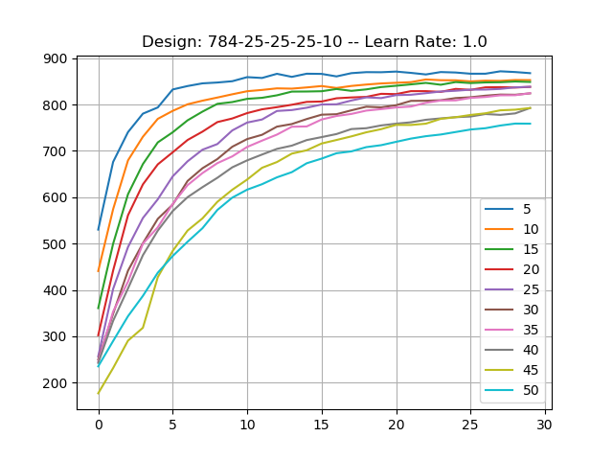
RESULTS:
Accuracy
Design & Analysis of Algorithms Spring 2018

Slide 8
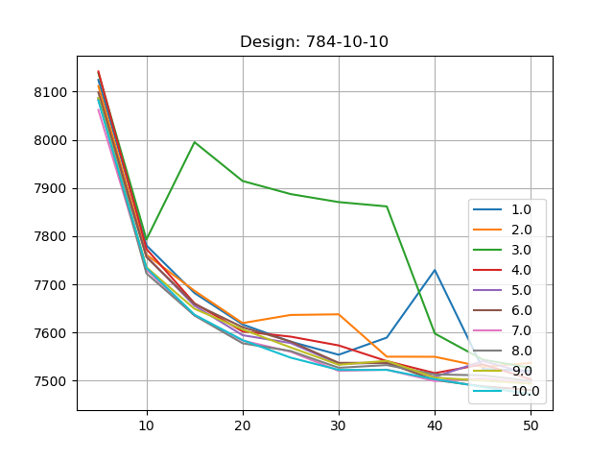
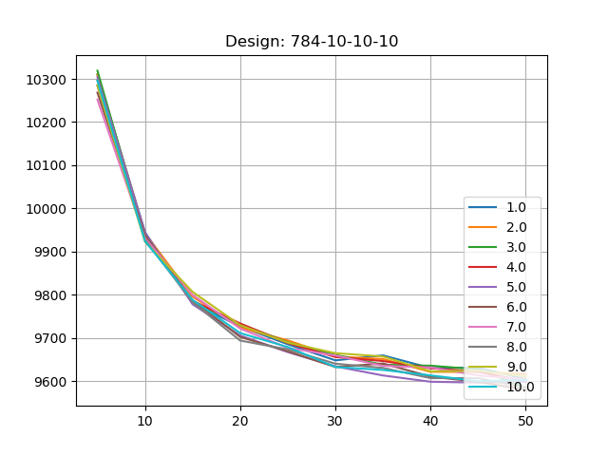
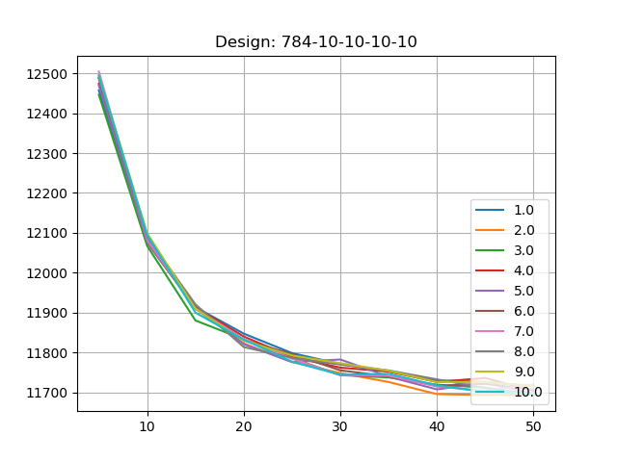
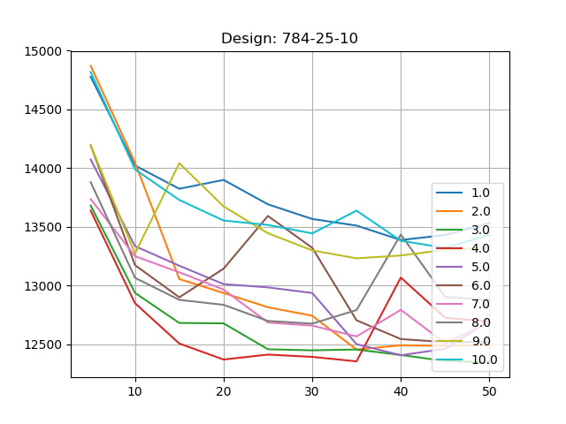
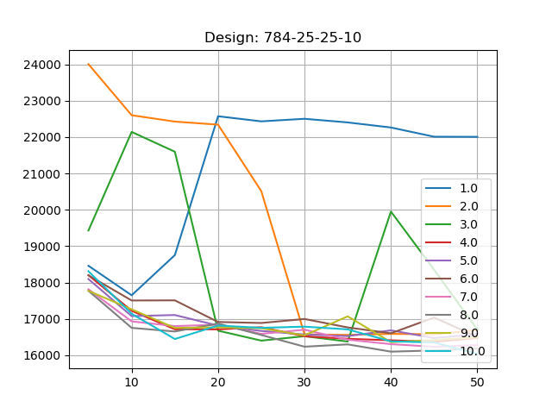
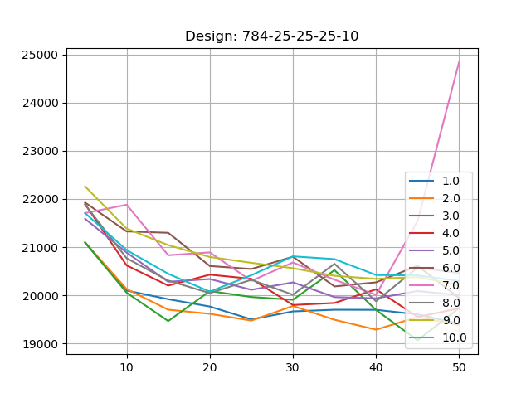
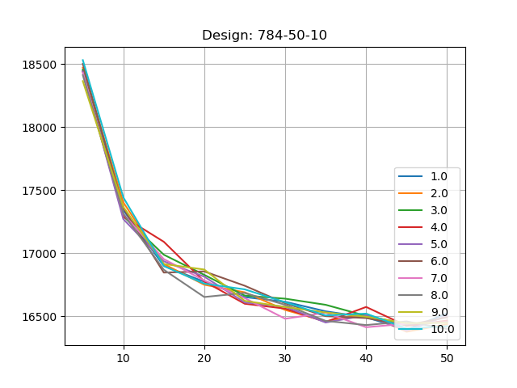
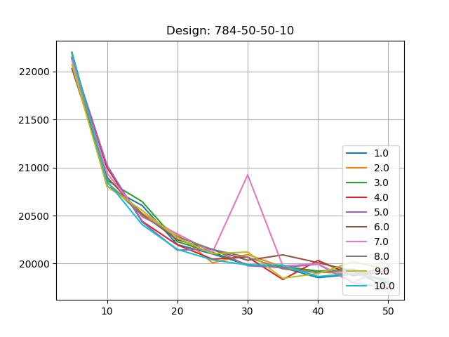
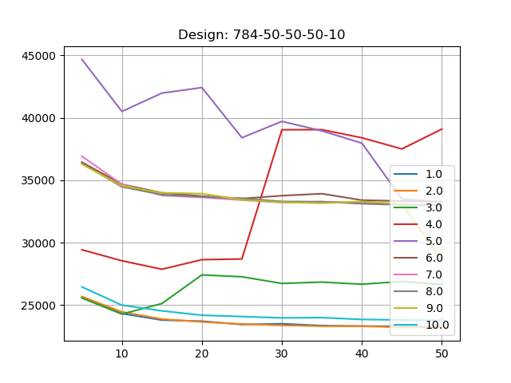
RESULTS:
Time
Design & Analysis of Algorithms Spring 2018

Slide 9
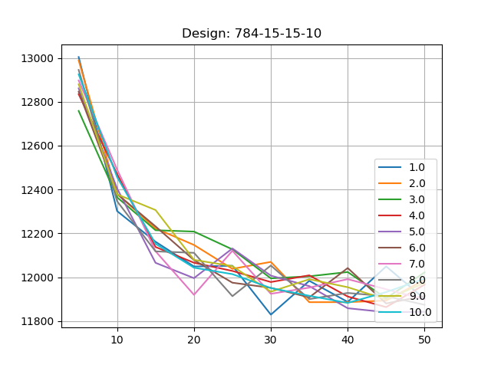
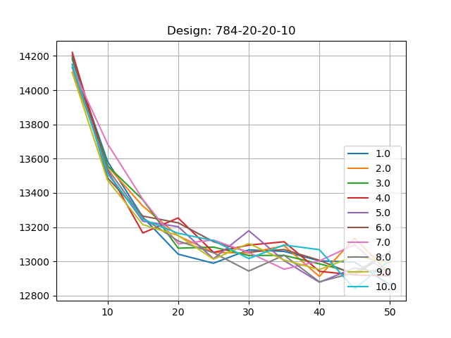
RESULTS:
Time
Design & Analysis of Algorithms Spring 2018

Slide 10
Design & Analysis of Algorithms Spring 2018

Slide 11
Design & Analysis of Algorithms Spring 2018

Slide 12
Design & Analysis of Algorithms Spring 2018

Slide 13
Design & Analysis of Algorithms Spring 2018

Slide 14
Design & Analysis of Algorithms Spring 2018

Slide 15
Design & Analysis of Algorithms Spring 2018

Slide 16
Design & Analysis of Algorithms Spring 2018

Slide 17
Design & Analysis of Algorithms Spring 2018

